Slide 1


POLITECNICO DI MILANO
PULSE
Keyword spotting with phase-change memory matrix-vector multiplication
Luca Rossi
Prof. Daniele Ielmini
Lorenzo Gentile

Slide 2

Dataset
Data Augmentation
Google Speech Commands v0.02
Added both pink and white noise to improve robustness
Time shifted the samples to improve temporal agnosticism
Pitch shifting to allow a wider spectrum of recognizable voices
Around 4000 samples file for each word
Each sample is 1s long and sampled at 16khz
Model trained with only 5 words (expandable)
20% of the samples used for validation and testing

Slide 3

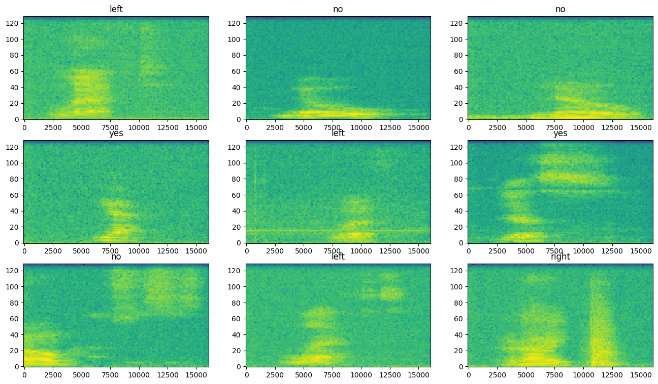
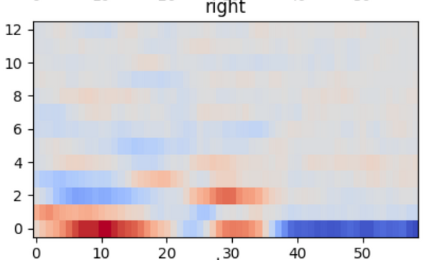
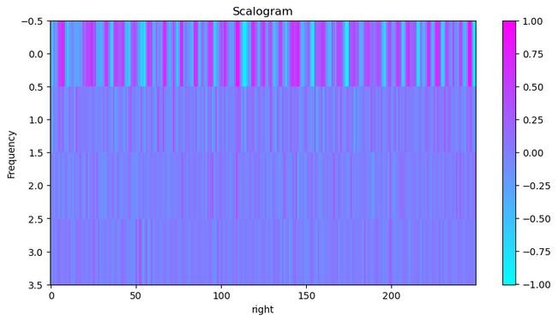
Audio to image representation
STFT
MFCC
DWT
Short Timed Fourier Transform
Size: 124x129 px
Larger but faster to compute
Mel-Frequency Cepstral Coefficients
Size: 59x13 px
Smaller but slower to compute
Discrete Wavelet Transform
Size: 250x4 px
Heavy accuracy loss

Slide 4

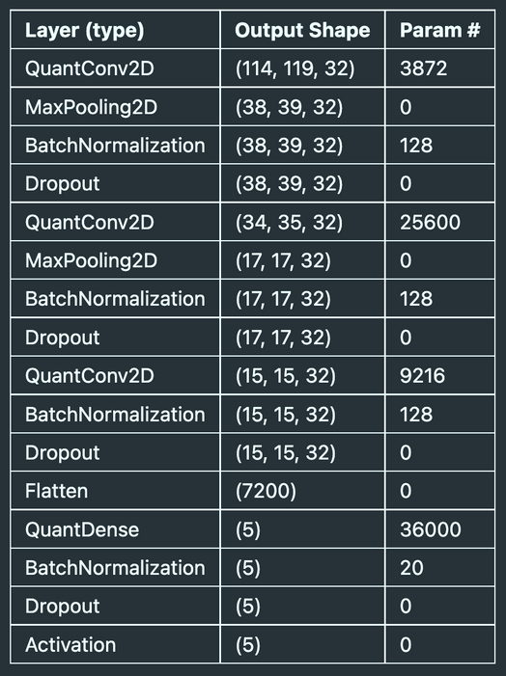
Model
Architecture
The model has three 2D Convolutional layers, each followed by a MaxPooling, a BatchNormalization and a Dropout layer.
The last layer is Dense with a SoftMax activation.
Both convolutional and dense layers do not have biases
Size
The final number of trainable parameters is 74.7k while the number of non-trainable parameters is 202 bringing the total to just under 75k
Accuracy
Accuracy on unseen data after 80 epochs is 95.5%

Slide 5

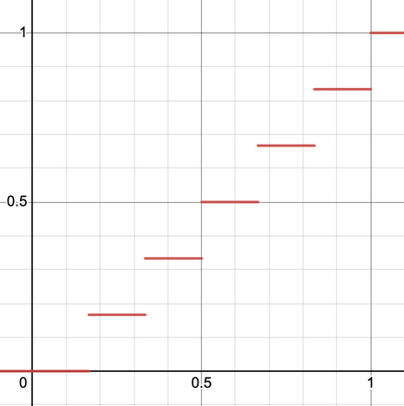
Quantization
Using LARQ, a library that adds quantized layers, we have implemented our own quantizers
Activation quantization
Weights quantization
DoReFa 3bit quantizer
Custom alphabet quantizer
Currently using 11 equally spaced levels
[-1, -0.8, -0.6, -0.4, -0.2, 0, 0.2, 0.4, 0.6, 0.8, 1]
User definable

Slide 6
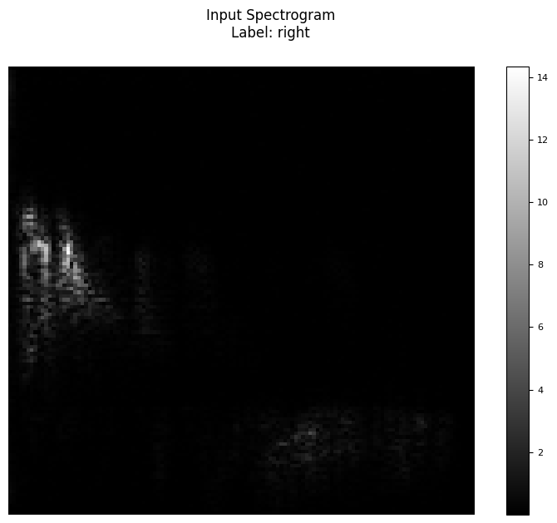
Journey Across the Layers

Slide 7
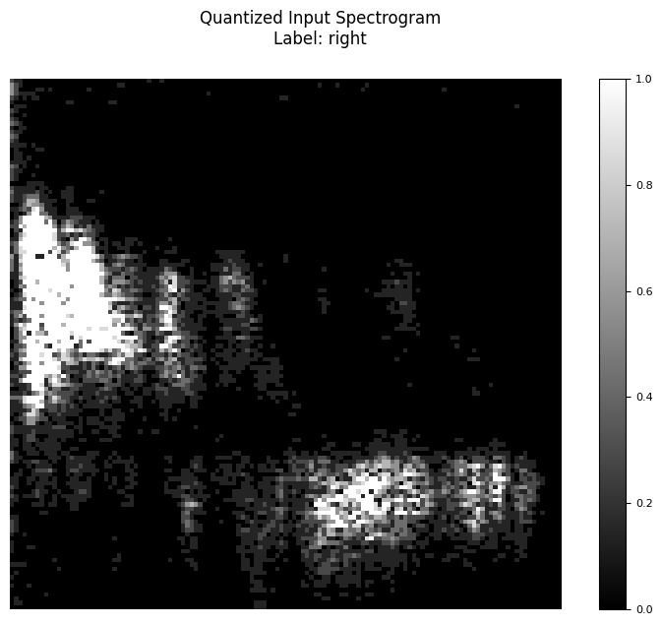
Journey Across the Layers

Slide 8
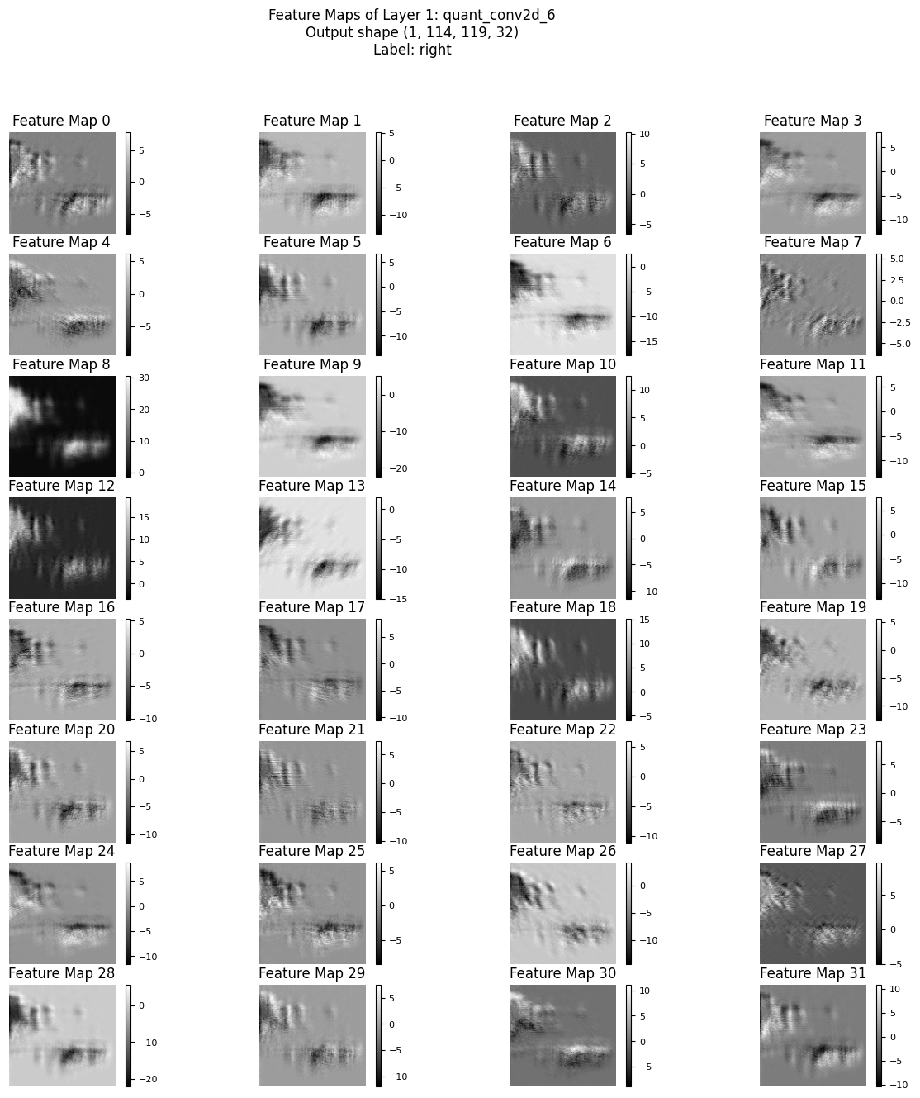
Journey Across the Layers

Slide 9
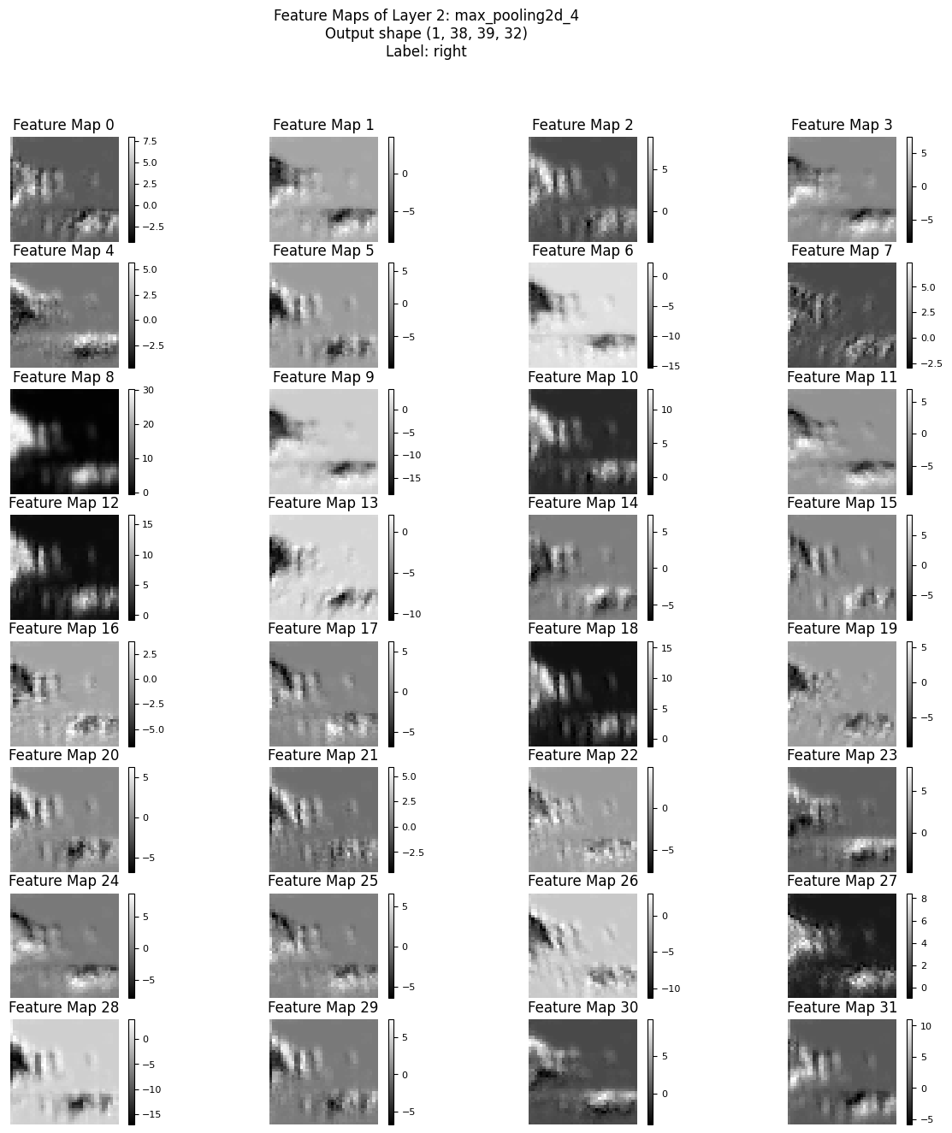
Journey Across the Layers

Slide 10
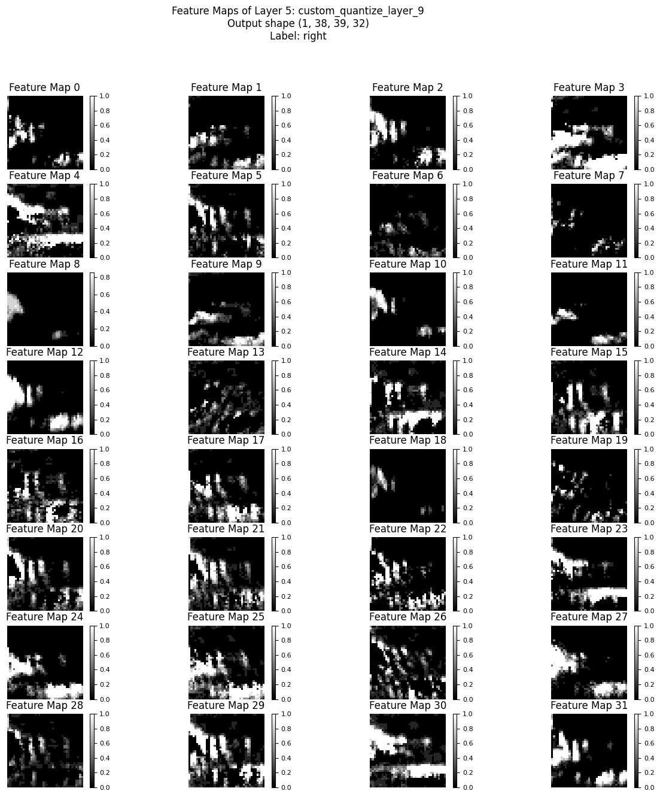
Journey Across the Layers

Slide 11
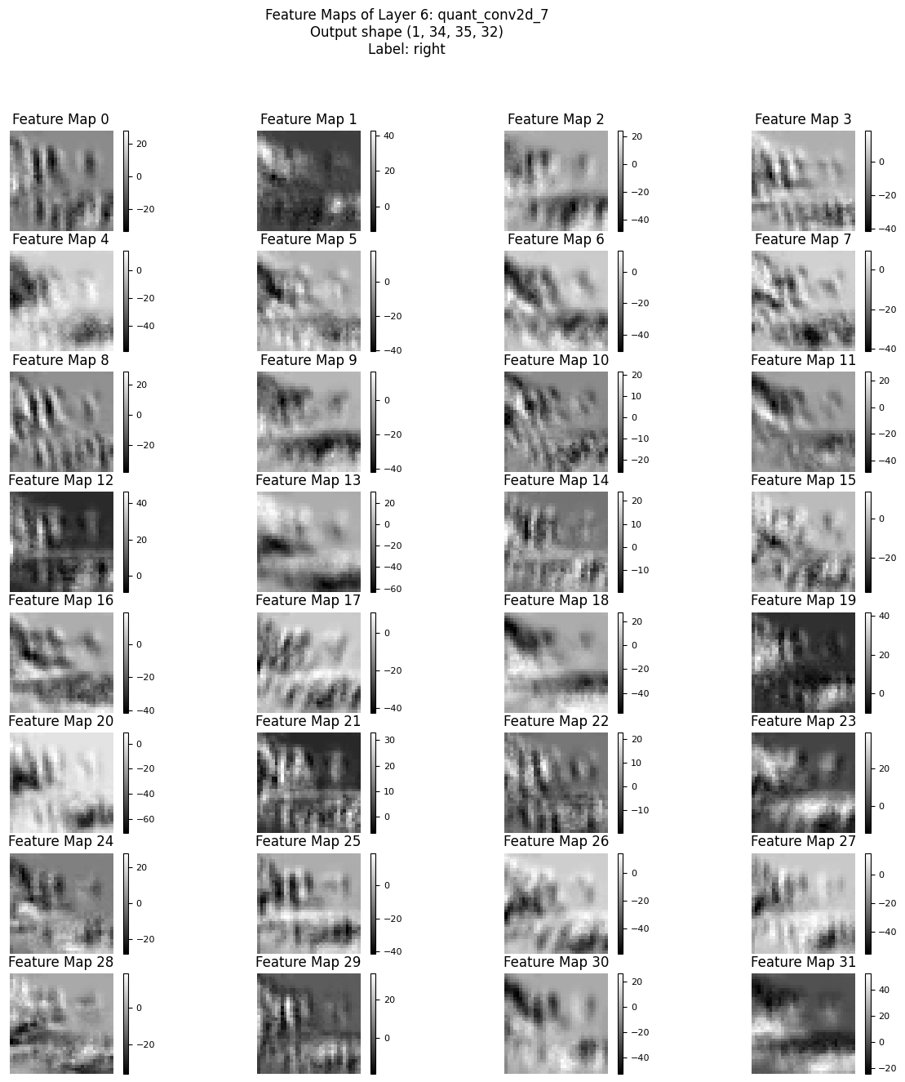
Journey Across the Layers

Slide 12
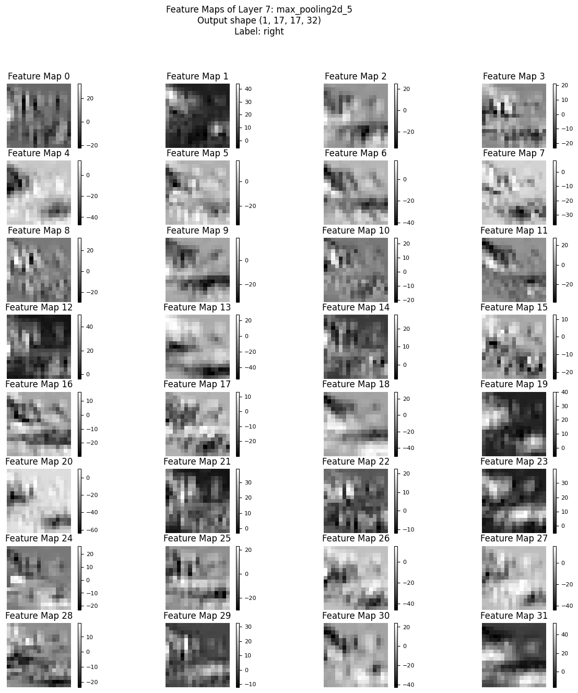
Journey Across the Layers

Slide 13
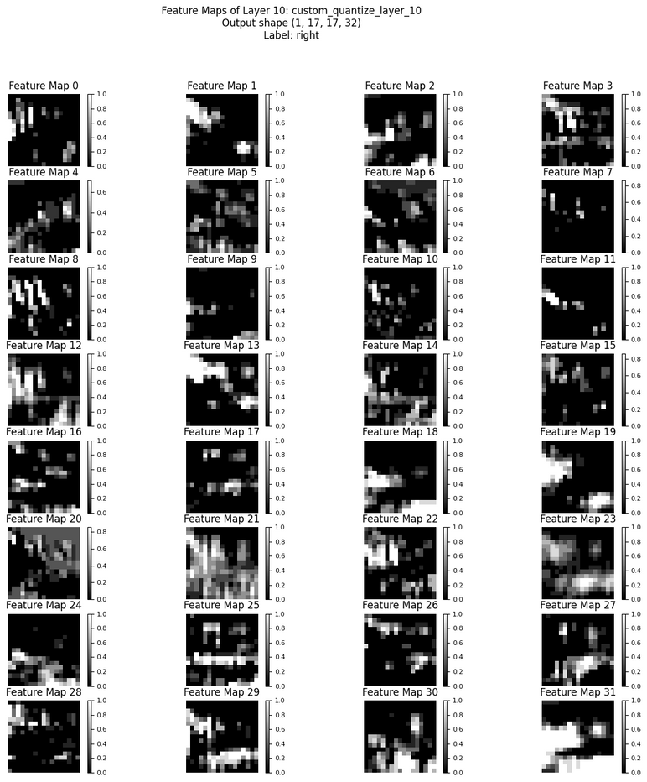
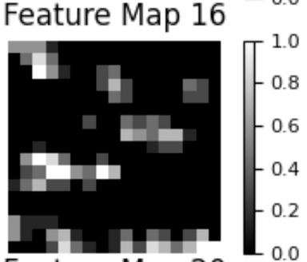
Journey Across the Layers

Slide 14
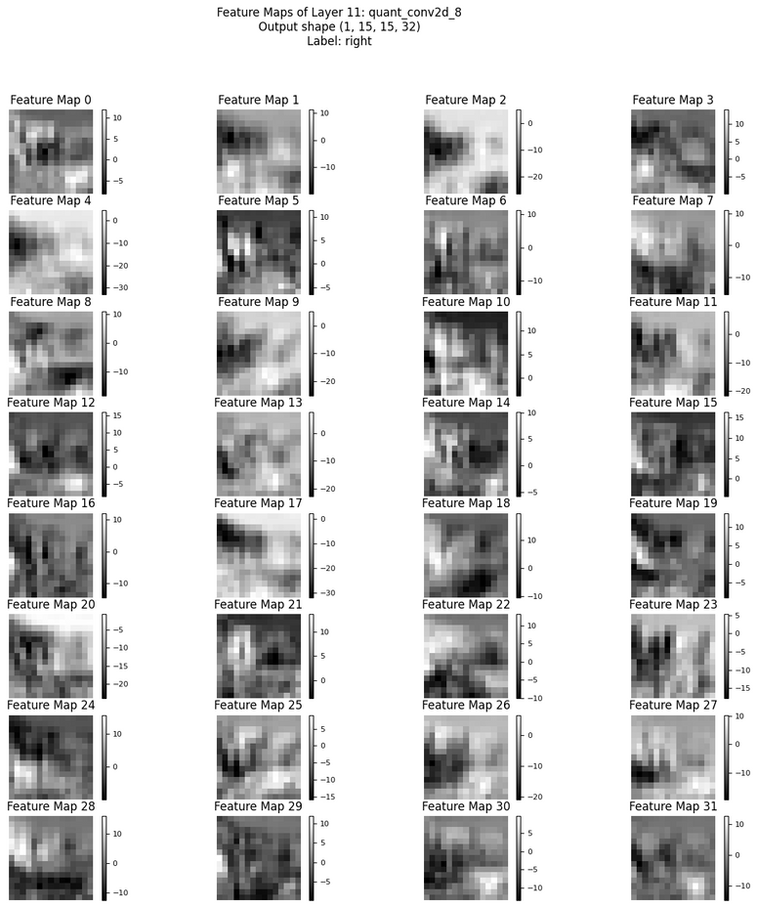
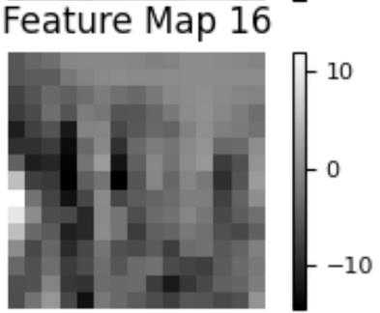
Journey Across the Layers

Slide 15
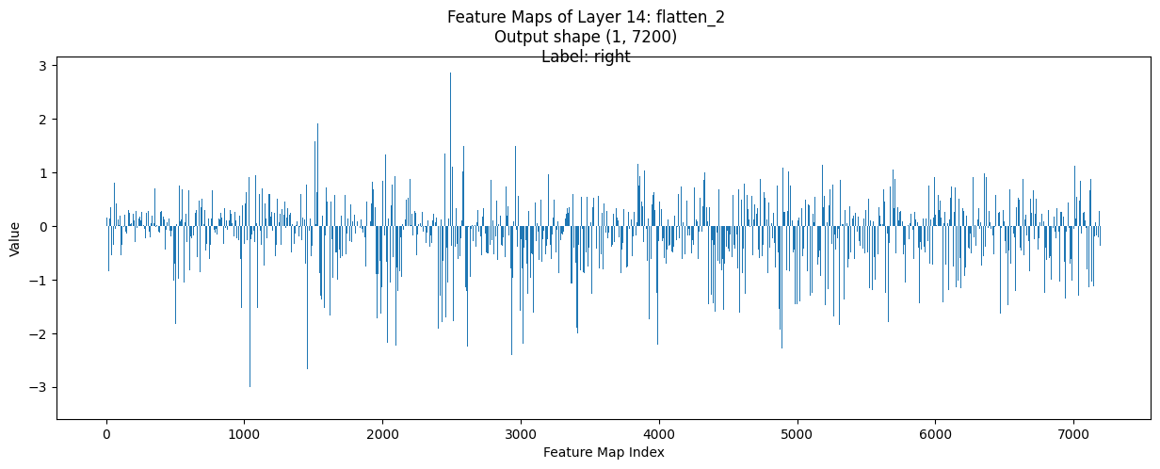
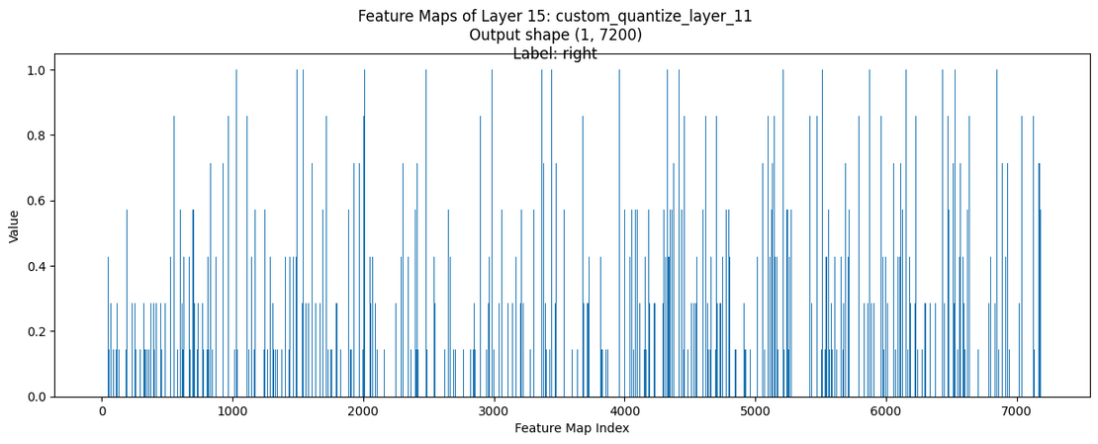
Journey Across the Layers

Slide 16
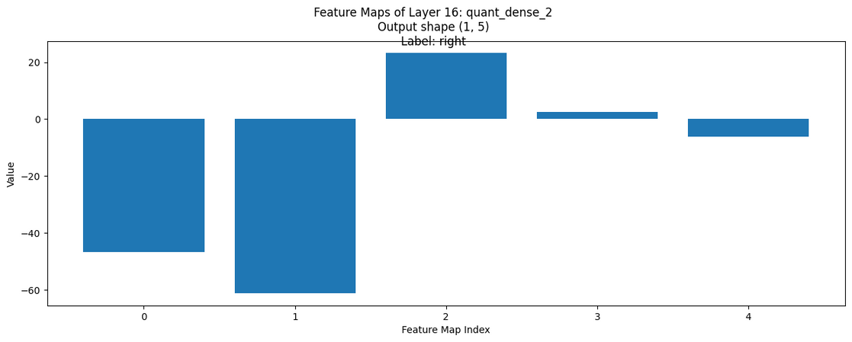
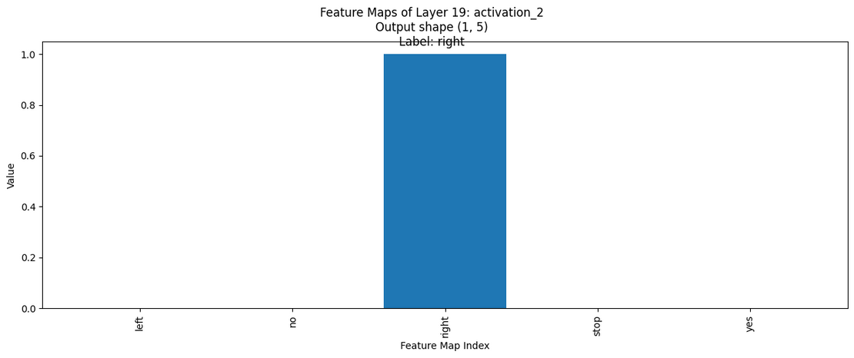
Journey Across the Layers

Slide 17
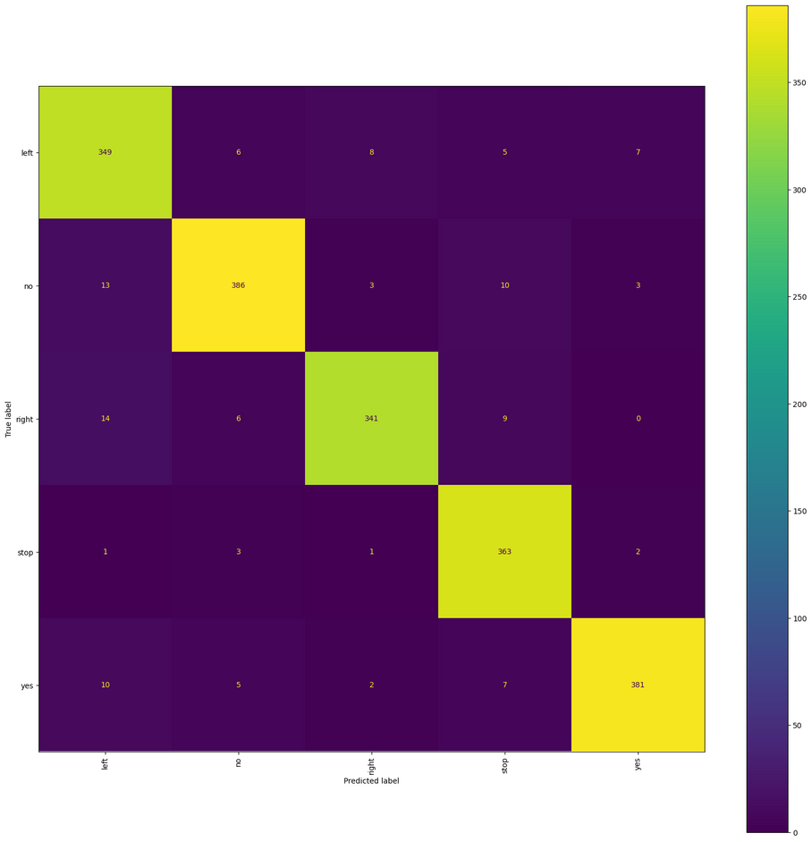
Confusion Matrix

